Slide 1
Zee-News Website
Dotnet/Angular Project

Slide 2
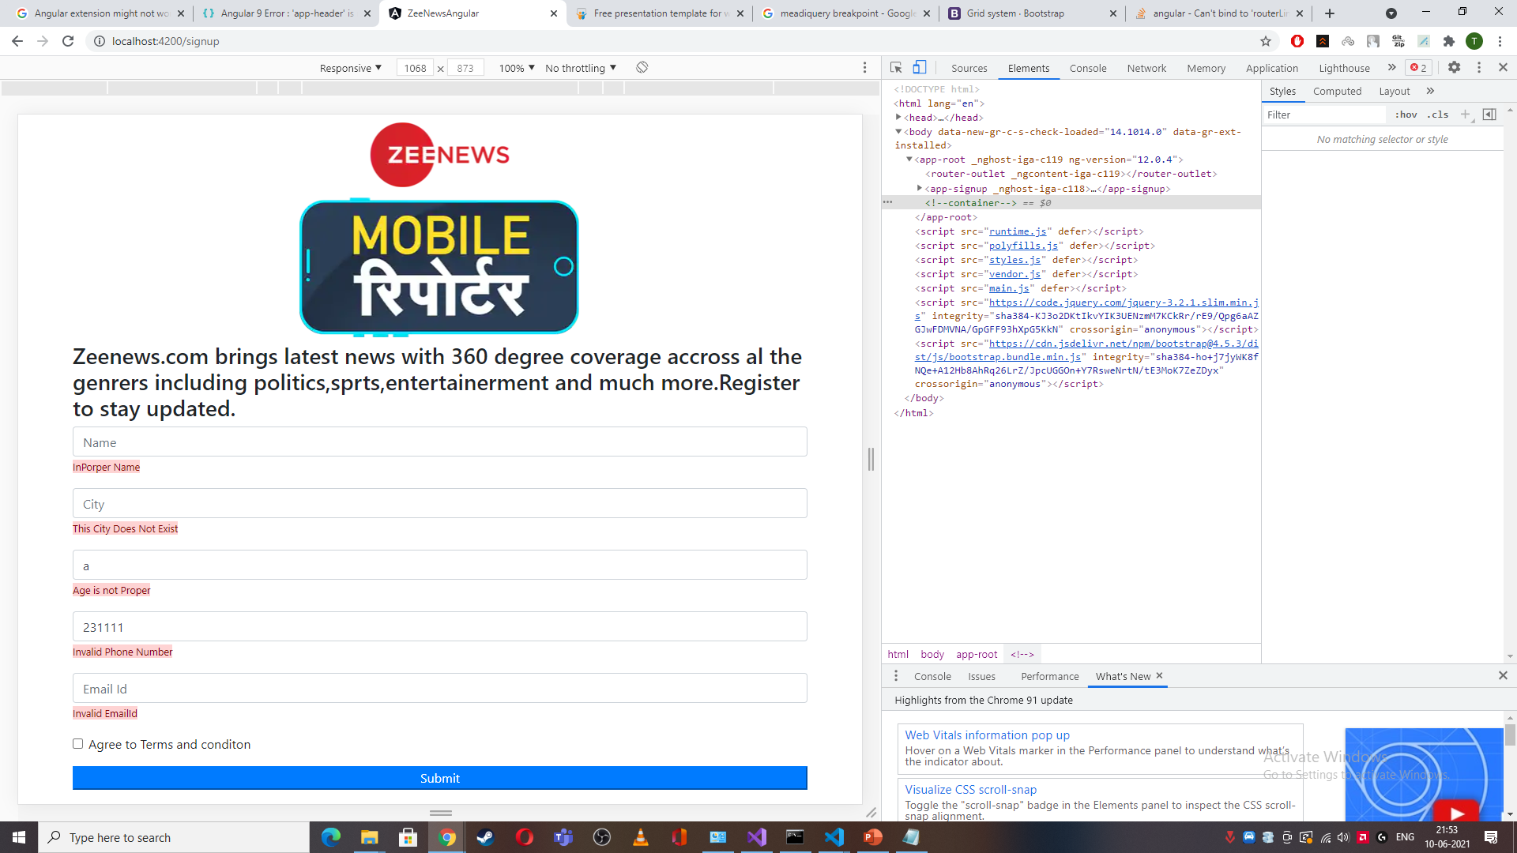
SignupComponent

Slide 3
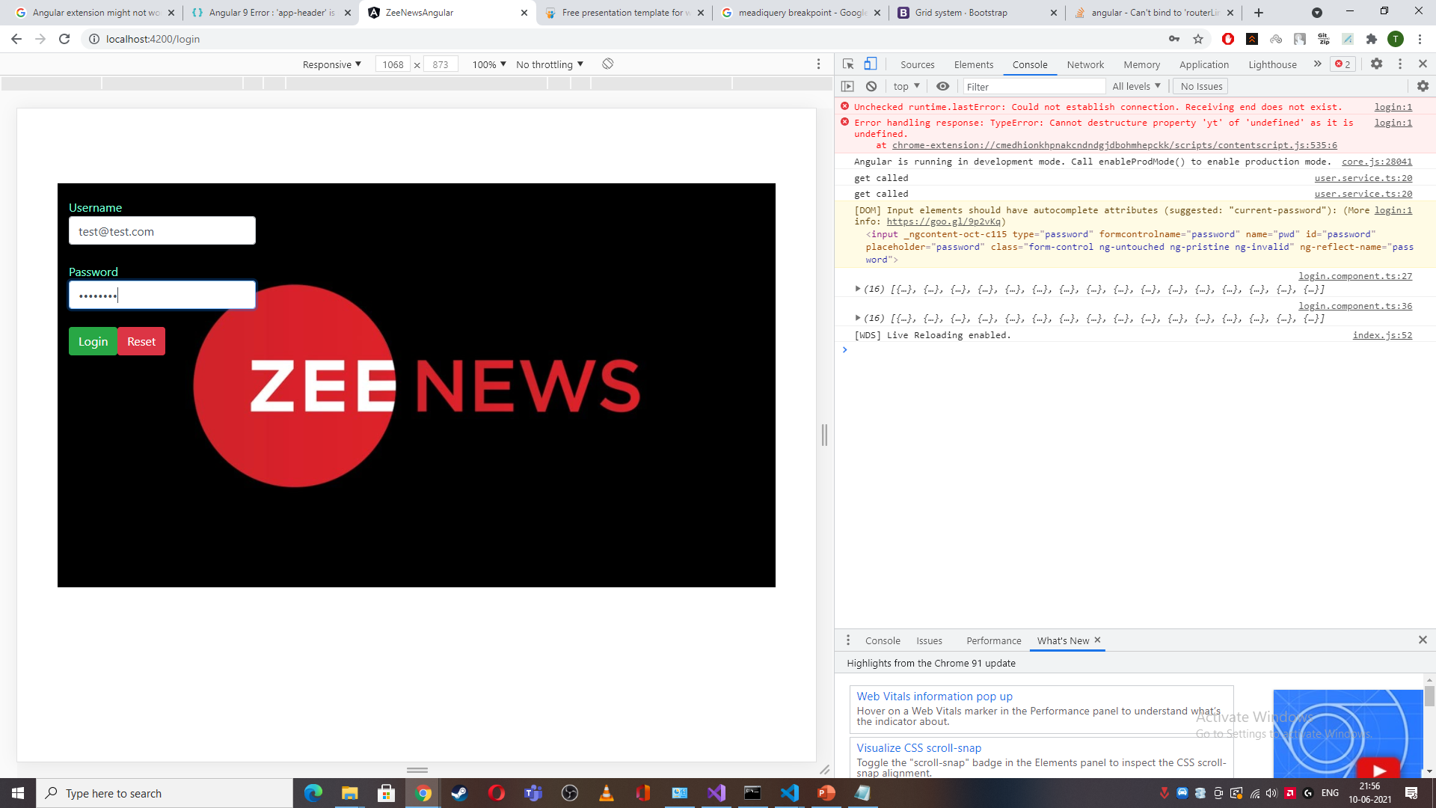
Login-Module

